Slide 1



Hadoop Tutorial
Hadoop HDFS Read and Write Operations

Slide 2
Hadoop Reads/Writes
HDFS follow Write once Read many models.
That means files already stored in HDFS, can not be edited.
But we can append into the existing file data by reopening the file.
In Read-Write operation client first, interact with the NameNode.
Now let’s see in details how client interacts with master and slave nodes in HDFS data write operations.

Slide 3

Hadoop Writes
To Write a file in HDFS, a client needs to interact with master i.e. namenode (master).
Now namenode provides the address of the datanodes (slaves) on which client will start writing the data.
NameNode provides privileges and other metadata information so, the client can easily read and write data blocks into/from the respective DataNodes.
Client directly writes data on the datanodes, now datanode will create data write pipeline to create the replica of the blocks based on the replication factor.
The first datanode will copy the block to another datanode, which intern copy it to the third datanode. Once it creates the replicas of blocks, it sends back the acknowledgment.

Slide 4

Client Node
NameNode
Client JVM
2. Create
Distributed File System
NameNode
1. Create
HDFS Client
7. Complete
3. Write
FSData OtputStream
6. Close
4.1 Write Block
5.3 Acknowledgement
Pipeline of
DataNodes
DataNode
4.2 Replica
DataNode
4.3 Replica
DataNode
5.2 Ack
5.1 Ack

Slide 5
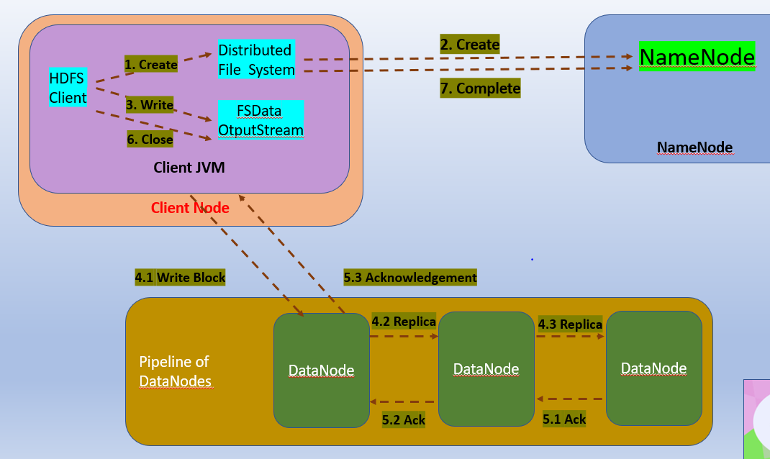

1) The HDFS client sends a create request on DistributedFileSystem APIs.
2) DistributedFileSystem makes an RPC call to the NN to create a new file in the file system’s namespace.
The NN checks for: Permissions and File not already exists.
3) The DistributedFileSystem returns a DFSDataOutputStream for the client to start writing data to .
DFSOutputStream splits it into blocks, which it writes to an internal queue, called the data queue.
The data queue is consumed by the DataStreamer, which eventually writes data blocks to the DNs.

Slide 6

4) The list of DNs form a pipeline. The DataStreamer streams the blocks to the first DN in the pipeline, which stores the packet and forwards it to the second DN in the pipeline. Similarly, the second DN stores the packet and forwards it to the third (and last) DN in the pipeline.
5) DFSOutputStream also maintains an internal ack queue.
A packet is removed from the ack queue only when it has been acknowledged by the DN in the pipeline.
DN sends the acknowledgment once required replicas are created (3 by default),
The data blocks are copied in parallel.

Slide 7

6) When the client has finished writing data, it calls close() on the stream.
7) This action flushes all the remaining packets to the DN pipeline and waits for acknowledgments before contacting the NN to signal that the file is complete.
The NN already knows which blocks the file is made up of, so it only has to wait for blocks to be minimally replicated before returning successfully, minimal replication is determined by the property : dfs.replication.min, default is 1

Slide 8
Thanks and do subscribe to my channel

Slide 9
In the next part , we will look at Hadoop Read operation in detail.

Slide 10
Hadoop Tutorial : Read and Write Operations
Client Node
NameNode
Client JVM
2. Create
Distributed File System
NameNode
1. Create
HDFS Client
7. Complete
3. Write
FSData OtputStream
6. Close
4.1 Write Block
5.3 Acknowledgement
Pipeline of
DataNodes
DataNode
4.2 Replica
DataNode
4.3 Replica
DataNode
5.2 Ack
5.1 Ack

